Slide 1
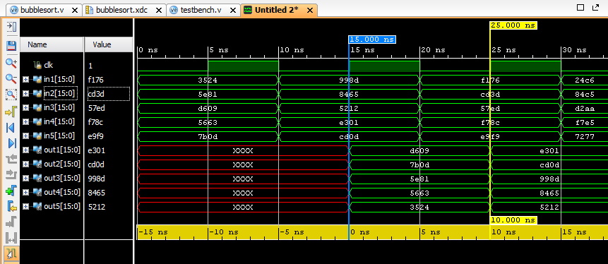
Bubblesort Design
Minimum clk period achieved = 25 ns
Maximum frequency = 40 MHz
Slice LUTs = 296
Slice Registers = 160
Design latency = 1 clk cycle

Slide 2
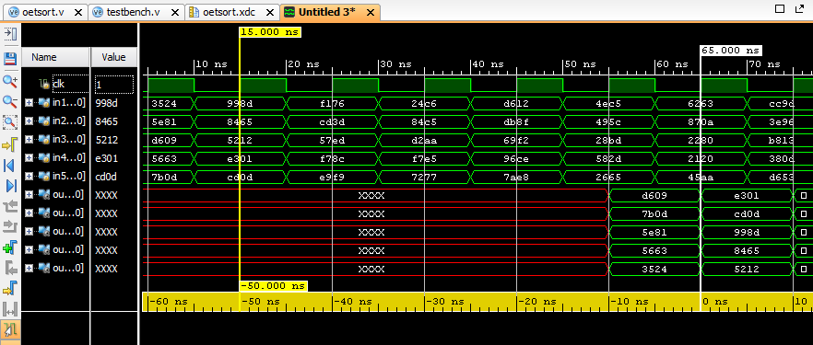
Odd-Even Design
Minimum clk period achieved = 4 ns
Maximum frequency = 250 MHz
Slice LUTs = 368
Slice Registers = 480
Design latency = 5 clk cycles

Slide 3
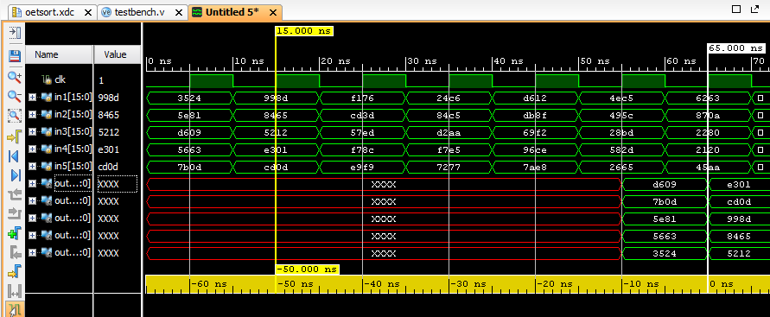
After Floorplanning
Minimum clk period achieved = 4.5 ns
Maximum frequency = 222.222 MHz
Slice LUTs = 352
Slice Registers = 480
Design latency = 5 clk cycles

Slide 4
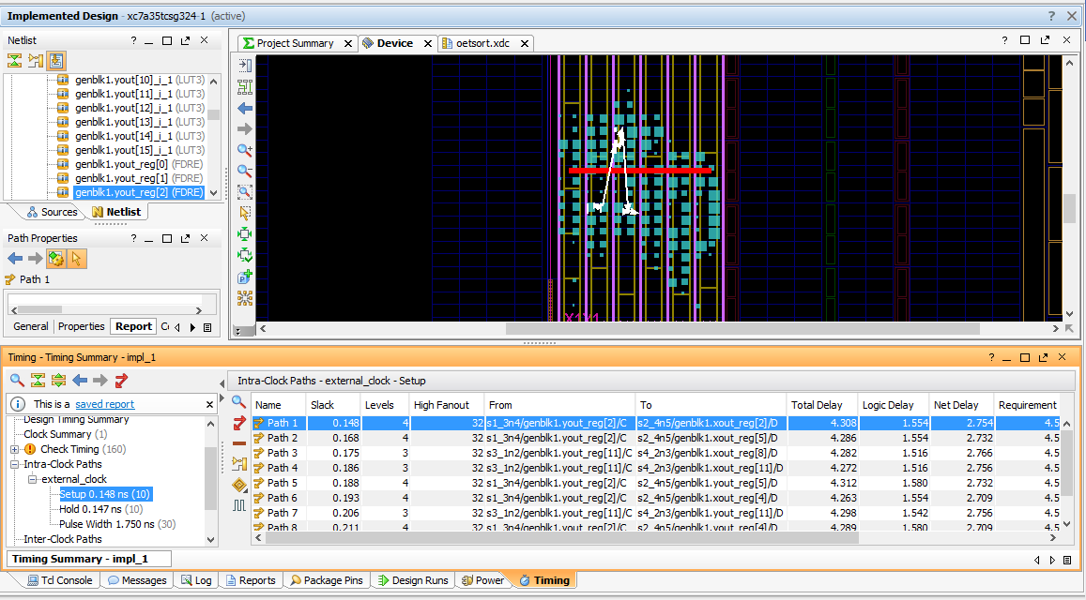
Floorplanning
Minimum clk period achieved = 4.5 ns
Maximum frequency = 222.222 MHz
Slice LUTs = 352
Slice Registers = 480
Path of minimum slack

